Slide 1
Nearpod
Miranda Jacobs
ITECH 7445
Dr. Grove
July 16, 2018
Emerging Technology

Slide 2
nearpod?
What is nearpod?
Nearpod is an interactive presentation and assessment tool that can be used in the classroom. Teachers can create presentations that contains Quiz’s Polls, Videos, Images, Drawing-Boards, Web Content and much more. Students can access the teacher’s presentation through a code that the teacher shares with students. Nearpod is a web-based app and is accessible on a “login” basis. Which means anyone can access their Nearpod account using any device that connects to the internet. Nearpod allows teachers to connect with their students in creative and innovative ways digitally.

Slide 3
Ware County Learning Center Technology Vision
Ware County Learning Center vision for technology in the learning environment is to use resources that allow students to stay up to date with our world’s ever-changing technology while allowing for appropriate use of technology to increase student engagement, enhance and support student learning.

Slide 4
Nearpod supports Ware County Learning Center Technology Vision?
How does Nearpod support Ware County Learning Center vision for technology in the learning environment?
Nearpod supports Ware County Learning Center vision for technology in the classroom by creating this resource that provides teachers with a platform to create learning experiences that engages and inspire students.
Nearpod supports Ware County Learning Center technology vision because they have full lessons available that educators can use to increase student engagement, enhance and support student learning.
Nearpod has assessments that teachers can use to assess students the knowledge and also students assessments that students can use for self-assessment to assess their knowledge of specific skills to improve their learning.

Slide 5
Objectives
The main objective of Nearpod is to engage students with interactive activities, connect them through collaborative discussions, and gain insight into student learning through formative assessments on the app.
Create interactive lessons
Easily download and customize ready-to-teach lessons to meet students needs
Comprehensive student assessments
Enable 100% student participation by allowing students to participate in every lesson actively
Allow students to take ownership of their learning by supporting and enhancing students sense-making which is central to taking ownership of knowledge

Slide 6
Key benefits
Students can experience interactive lessons at their own pace.
Lessons can be modified for individual or small group assignments.
Provide students with collaboration activities.
Teachers can see student’s answers in real time, access post-session data and obtain detailed reports.
Teachers can differentiate lessons and activities to fit the individual needs of each student.

Slide 7
Target population
Nearpod was created for grades K– 12.
Nearpod is tailored to provide resources to all four content areas: Mathematics, Social Studies, Science and English Language Arts.
For my classroom use, Nearpod will be used for grades 6th – 8th Mathematics.
Nearpod will be used for gifted, general education, and special education students in my classroom.
All Ware County Learning Center students
For my classroom, 1:1 technology because students have an assigned Chromebook to work on daily in the classroom.
Students and teachers that have access to any device that connects to the internet.

Slide 8
Equipment and software
Nearpod can work on any device such as computers, Chromebooks, smartphones, iPads, tablets.
The Nearpod app can be downloaded from digital outlets.
Nearpod is accessible with the use of the internet (Wi-Fi).
VR (Virtual Reality) headsets to access VR lessons that Nearpod offers.
Headphones are not required for a majority of the learning experiences but are ideal for students to use for privacy and contain noise levels.

Slide 9
Technical support
Ware County Schools has an amazing technology department that assists all of its schools with technology support.
Nearpod offers technical support.
Nearpod offers a demo (training) of the app.
The Nearpod site has a video that provides an overview of the app.
Nearpod offers a help center that addresses questions and concerns. If you are not able to find the answer to your question or concern you can contact their team which allows you to submit a request; by providing your email address, the subject and description of your request.

Slide 10
Limitations
The students must have individual Nearpod accounts so that teachers can track students data and obtain individual detailed reports.
Nearpod does not work without an internet connection.
If no internet or device that accesses the internet at home, students can only use Nearpod at school to complete learning experiences.
Students parent(s) or guardian(s) must sign an internet use form permitting for students to use the internet while at school.
At school, students must have access to devices that can connect to the internet and the internet must work.

Slide 11
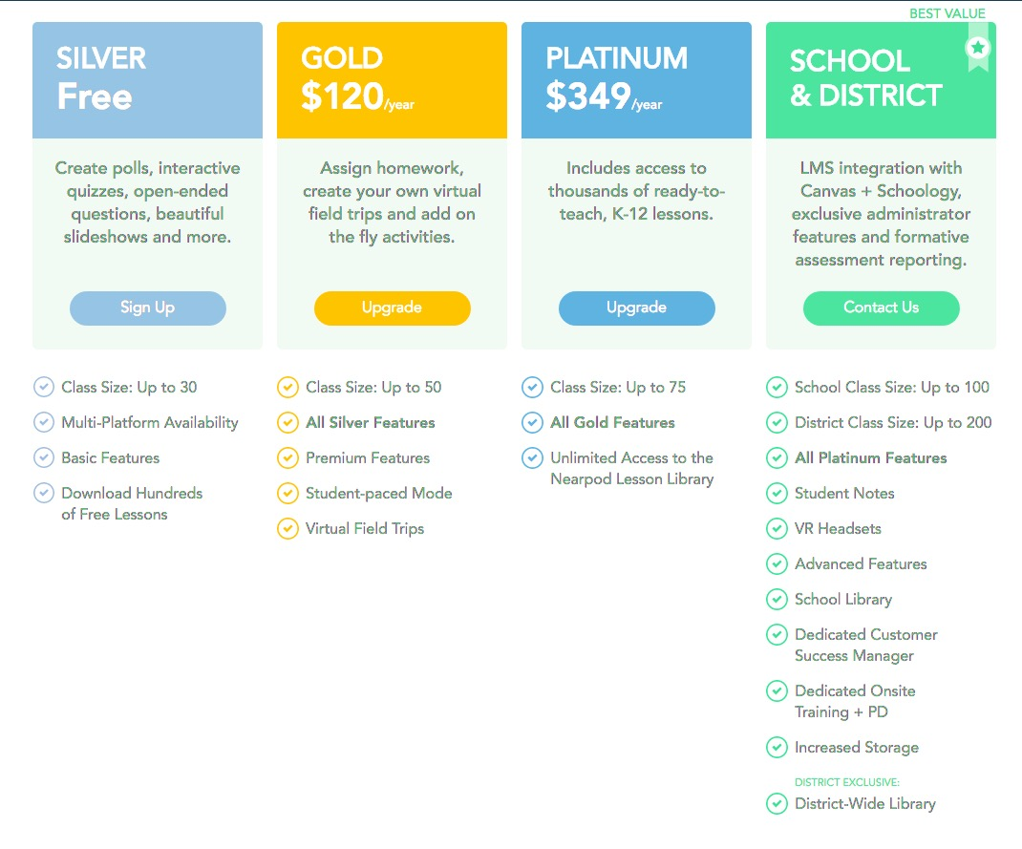
Nearpod pricing
Nearpod offers four different prices:

Slide 12
Potential funding sources
Ware County Schools are Title 1 schools and could use Title 1 funding to purchase resources.
Available school funds can be used to purchase packages that require payment.
Educators can write grants to fund resources that require payment.

Slide 13
How do we use this technology?
Nearpod is used in the classroom for the following reasons:
Simple presentation delivery- substitute for other presentation tools. For instance, instead of using a PowerPoint presentation you can use this app. The presentation would be accessible to student’s devices to ensure that all students can view the presentation without any problems. Students can zoom into areas of the presentation for better visualizations.
Personalized Provision- teachers can modify the apps use to an individual student or small group activity.
Distributing Resources- teachers can upload images and worksheets to the presentation saving paper and as a backup copy for students access just in case students misplace the worksheets or images.
Live and formative assessments- teachers can create quizzes and view live results and data.

Slide 14
How do we use this technology cont’d?
Ongoing Assessment- teachers can use quizzes throughout assignments for ongoing assessment data.
Self Assessment- students can evaluate their performance providing students with a unique self-evaluation strategy by providing students with a red light which indicates that they have a poor confidence level meaning that they are below performance on a certain skill. Next, is the amber colored light which indicates a fair understanding, meaning students are showing signs of understanding but have not yet mastered the skill. Lastly, the green light indicates a very good understanding of the learning topic, meaning that students are showing mastery over that certain skill.
Open-Ended Tasks- teachers ask a question or create a scenario for students to write about. This feature facilitates writing tasks.

Slide 15
How does nearpod promote specific learning goals?
Teachers can assign certain learning experiences over specific skills that students need to master, however:
Students can work on a specific skill individually
Students can be grouped in small groups that need to master specific skills
The available resources will help students master learning goals
Ongoing formative assessments will provide students with practice and feedback on skills
Nearpod promotes higher-level thinking, problem-solving, open-ended questions, and real-world connections.

Slide 16
How can nearpod be used for differentiation?
Teachers can use Nearpod to differentiate instruction by:
Modifying lessons to meet students individual needs
Setting app for small group assignments
Using Nearpod as remediation or enrichment activities
The software being used to collaborate with others
Using this app a visual component for visual learners
Setting lessons for student pace
Track student progress using ongoing assessments that have been modified for students specific learning goals

Slide 17
How does nearpod promotes communication?
Students can work collaboratively and interact with their peers.
Students can communicate with their teachers.
Teachers and students can publish their learning experiences sharing with the entire world.
With students having the ability to access Nearpod from anywhere with an internet connection may increase the communication between students and the parent(s) or guardian(s).

Slide 18
Research evaluation
According to the website, ”commonsense.org” Nearpod is an interactive slideshow tool that engages students promoting collaboration. Stating that some pros of Nearpod are students becoming active participants in their education while teachers get valuable feedback on student learning. Some cons of Nearpod are when creating and modifying presentations can be time-consuming and can get expensive; the preview feature has some lags. Lastly, the bottom line is this effective tool leverages the capabilities of 1 – to -1 environments and brings slide shows into the 21st century. (Rogowski, 2017)
I agree that Nearpod is interactive but think that it is more than just an interactive slideshow. This resource does promote collaboration and student engagement. While I have never used Nearpod, I am sure that creating and modifying presentations can become time-consuming and expensive as I noticed that they have pricing for individual lessons.

Slide 19
Research evaluation
According to the Center for Innovation in Research and Teaching, Nearpod has two main components. First, it is a delivery system that allows a teacher (1) to send content to students on a variety of platforms, such as laptops, tablets, and phones, (2) collaborate in real time with students, and (3) assess student performance. Secondly, Nearpod has headsets available that provide a virtual reality experience for viewing video content. Stating that this technology can be used in the classroom to create multimedia content, share content, assess work, analytics, and virtual reality. (CIRT)
I agree with this statement; the Nearpod app can be used on multi-media platforms as listed above, providing collaboration with and between students, provides ongoing and formative assessments. Nearpod can be used to access students assessment data and also to take students on Virtual field trips.

Slide 20
Research evaluation
Marilou V. teaches science and stated that “Nearpod makes it possible for students to ask me questions ‘online’ and a one on one discussion can be had to determine their issue. Or I can click on a students name, using our interactive whiteboard which Nearpod is projected on, and we can have a class discussion about their answers or ideas on a subject. It has dramatically increased student engagement. Nearpod instantly makes it possible to see who is turning in work and who is not because each student has their own logon and they turn in work digitally at the end of the lesson. Still there are some that just don’t want to do the work. But many more are involved.” Marilou V., 2017)
My thoughts are, I like that students can ask the teacher questions online because some students are embarrassed to ask questions out loud and tool eliminates the fear of asking questions for understanding. This teacher makes a valid point that some students are not going to do the work no matter how engaging the lesson is.

Slide 21
Implementation plan
Teachers will have professional development with school’s instructional coach to discuss how they will implement Nearpod in the classroom.
Teachers will review the student’s data after using Nearpod for a few weeks.
If data shows improvement in students performance, the school will allow teachers to continue use of Nearpod in the classroom.
Teachers should reflect on observing students using Nearpod and share whether or not students were engaged during the instructional time while using the app.

Slide 22
Professional learning
Professional learning will be provided and required for all teachers over Nearpod.
Nearpod offers ready to Run PD packages based on research that are 1-hours sessions created by experts and someone in your school can present the Run PD to teachers during professional learning meetings.
Each teacher will have access to a computer that they can use to access Nearpod during professional development.
Video tutorials on using Nearpod can be viewed during professional learning for teachers to get a visual.

Slide 23
Reflection
I was interested in completing this evaluating emerging technology project over Nearpod as my choice of technology resource to research because a few of my classmates in this class have mentioned using Nearpod in their classes. After researching Nearpod, I have concluded that Nearpod is an effective resource that teachers can use as a mean of remediation, a lesson opener or “hook,” an interactive presentation delivery and a method to formative assess students and share resources . I believe that students will become more engaged during instructional time if Nearpod was implemented in my class. I teach math, and I looked at a few learning experiences I am sure the students would love to complete not realizing they are learning. Also, with Nearpod teachers can differentiate lessons while still including higher-level thinking skills for students.

Slide 24
Reflection continued
I like that Nearpod provides a tool for students to ask the teacher a question online about the skill they are working on. By giving students the option to ask the teacher a question or for help with a skill they are working on will minimize the embarrassment of students not wanting to ask a question and failing to receive the explanation needed to gain a clear understanding.
Overall, I am going to encourage my principal to look into Nearpod because I believe that this resource will be beneficial to our students while promoting engaging and collaborative learning.

Slide 25
References
10 Ways to Use Nearpod in the Classroom - Nearpod Blog. (2018, May 14). Retrieved from https://nearpod.com/blog/10-ways-to-use-nearpod-in-the-classroom/
An interactive lesson delivery and formative assessment platform. (n.d.). Retrieved from http://thelearningcounsel.com/article/interactive-lesson-delivery-and-formative-assessment-platform
Center for Innovation in Research and Teaching. (n.d.). Retrieved from https://cirt.gcu.edu/teaching3/tools/nearpod
Launch it. Lead it. Love it. (n.d.). Retrieved from https://nearpod.com/ready-to-run-pd
Pricing | Nearpod. (n.d.). Retrieved from https://nearpod.com/pricing
Rogowski, M. (2018, July 15). Nearpod. Retrieved from https://www.commonsense.org/education/app/nearpod

Slide 26
References
(n.d.). Retrieved from https://www.google.com/search?q=Nearpod pricing&source=lnms&tbm=isch&sa=X&ved=0ahUKEwjkgvvOzaTcAhVOJKwKHb6NAhIQ_AUIDCgD&biw=927&bih=594#imgrc=jIlcTbHTnKr8vM:

